Slide 1
WE WERE HERE FIRST!
The story of the Aztec and Inca Empires

Slide 2
EXPLORATION SUPPLIES:
PIECE OF PAPER
PEN OR PENCIL
EAR PHONES OR EAR BUDS
HISTORICAL THINKING MINDSET

Slide 3
MEET THE AZTECS
CAPTIAL CITY OF TENOCHTITLAN (CURRENT DAY MEXICO CITY)
Visit the link to learn more about the amazing Aztec Empire. Use your paper to record the answers to the 10 question quiz at the end of the passage.

Slide 4
PONDER THIS:
The Spanish destroyed the Aztec capital city and built the Spanish cities over the ruins. Descendants of the native people were oppressed and denied education, land, and a voice in their future. The Spanish ruled over Mexico from 1520 until independence was gained in 1810! It has been a hard fight to gain back what was lost. In what ways do you think the people of Mexico are still suffering from the Spanish control? (answer on your paper)

Slide 5
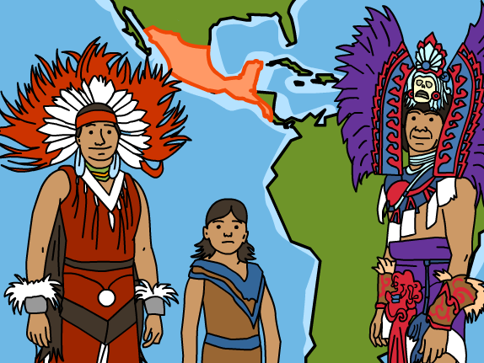
Brain pop
Log into CDL and open BRAINPOP. You will watch the video about the AZTEC-write 5 facts from the video on your paper.

Slide 6
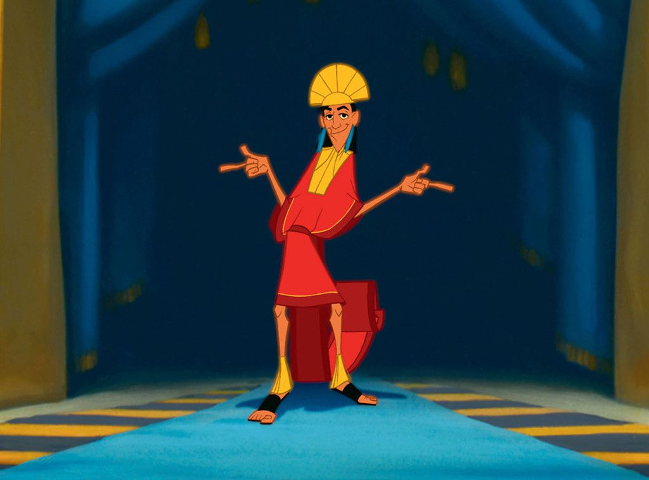
MEET THE incas
CAPTIAL CITY OF CUZCO (CURRENT DAY LIMA, PERU)
Visit the link to learn more about the amazing Inca Empire. Use your paper to record the answers to the 10 question quiz at the end of the passage.

Slide 7
PONDER THIS:
The Spanish destroyed the INCA capital city and built the Spanish cities over the ruins. Descendants of the native people were oppressed and denied education, land, and a voice in their future. The Spanish ruled over Peru from 1532 until independence was gained in 1821! It has been a hard fight to gain back what was lost. In what ways do you think the people of Peru are still suffering from the Spanish control? (answer on your paper)

Slide 8
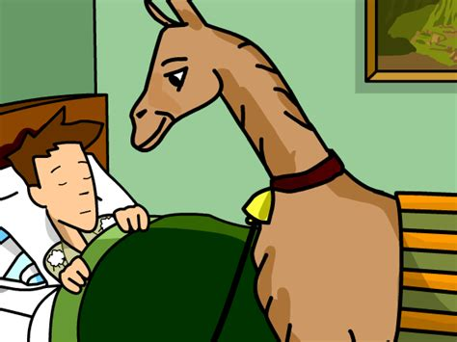
Brain pop
Log into CDL and open BRAINPOP. You will watch the video about the INCA-write 5 facts from the video on your paper.

Slide 9
What remains of the Spanish control?
Languages
Religion
Horses
Food items were traded between the NEW World (Americas) and the OLD World (Europe)

