Slide 1
Capitols
Newfoundland and Labrador: St. John’s
Alberta: Edmonton
British Columbia: Victoria
Ontario: Toronto
Quebec: Quebec City
Prince Edward Island: Charlottetown
Saskatchewan: Regina
Nunavut: Iqaluit
Manitoba: Winnipeg
Yukon: Whitehorse
Nova Scotia: Halifax
New Brunswick: Fredericton
Northwest Territories: Yellowknife

Slide 2
How am I supposed to remember all of this!?
Territories
and
Provinces
START HERE
Let’s make a mnemonic!
Start in the northwest corner and move in a clockwise motion as shown
FIN

Slide 3
Mnemonic- phrase to help you remember the order of lists
Yukon
Northwest Territories
NuNavut
Newfoundland and Labrador
Nova SCotia
Prince Edward Island
New Brunswick
Quebec
Ontario
Manitoba
Saskatchewan
Alberta
British Columbia
Young
NaughTy
NiNja
NarwhaLs
SCarcely
Play
Brutal
Quidditch
On
Majestic
Seas
All while
Baking Cake

Slide 4
How am I supposed to remember all of this!?
Territories
and
Provinces
START HERE
FIN
Let’s make a mnemonic!
Start on the left and move right

Slide 5
Mnemonic- phrase to help you remember the order of lists
Yukon
Northwest Territories
Nunavut
Yucky
Noses Terrify
Nuns

Slide 6
How am I supposed to remember all of this!?
Let’s make a mnemonic!
Start on the left and move right
START HERE
FIN
Territories
and
Provinces

Slide 7
Mnemonic- phrase to help you remember the order of lists
British Columbia
Alberta
Saskatchewan
Manitoba
Ontario
Quebec
Newfoundland and Labrador
Bring Canned
Asparagus
So
Men
On
Quilts
Never Labor

Slide 8
How am I supposed to remember all of this!?
Let’s make a mnemonic!
Start on the left and move right
Territories
and
Provinces
START HERE
FIN

Slide 9
Mnemonic- phrase to help you remember the order of lists
New Brunswick
Prince Edward Island
Nova Scotia
Newly
Printed
Scary Novels

Slide 10
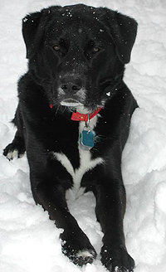
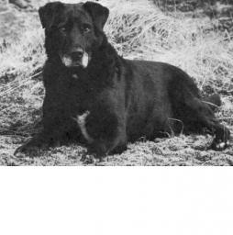
What about the capitals?
Newfoundland and Labrador: St. John’s
Alberta: Edmonton
British Columbia: Victoria
Ontario: Toronto
Quebec: Quebec City
Prince Edward Island: Charlottetown
Saskatchewan: Regina
Nunavut: Iqaluit
Manitoba: Winnipeg
Yukon: Whitehorse
Nova Scotia: Halifax
New Brunswick: Fredericton
Northwest Territories: Yellowknife
Newfoundland and Labrador = St. John’s
This is called a St. John’s Water Dog
St. John’s Water Dog … Labrador … get it?

Slide 11
What about the capitals?
Newfoundland and Labrador: St. John’s
Alberta: Edmonton
British Columbia: Victoria
Ontario: Toronto
Quebec: Quebec City
Prince Edward Island: Charlottetown
Saskatchewan: Regina
Nunavut: Iqaluit
Manitoba: Winnipeg
Yukon: Whitehorse
Nova Scotia: Halifax
New Brunswick: Fredericton
Northwest Territories: Yellowknife
British Columbia = Victoria
Ontario = Toronto
Quebec = Quebec City … duh …

Slide 12
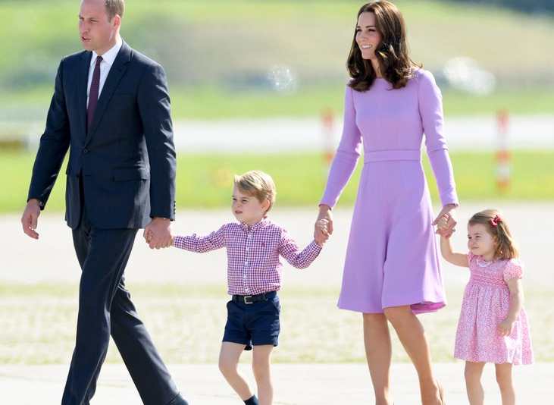
What about the capitals?
Newfoundland and Labrador: St. John’s
Alberta: Edmonton
British Columbia: Victoria
Ontario: Toronto
Quebec: Quebec City
Prince Edward Island: Charlottetown
Saskatchewan: Regina
Nunavut: Iqaluit
Manitoba: Winnipeg
Yukon: Whitehorse
Nova Scotia: Halifax
New Brunswick: Fredericton
Northwest Territories: Yellowknife
Prince Edward Island = Charlottetown
Prince George and Princess Charlotte

Slide 13
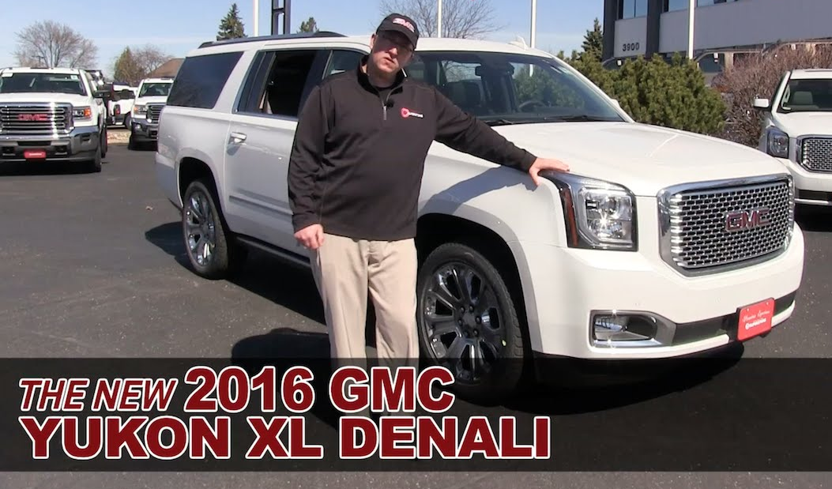
What about the capitals?
Newfoundland and Labrador: St. John’s
Alberta: Edmonton
British Columbia: Victoria
Ontario: Toronto
Quebec: Quebec City
Prince Edward Island: Charlottetown
Saskatchewan: Regina
Nunavut: Iqaluit
Manitoba: Winnipeg
Yukon: Whitehorse
Nova Scotia: Halifax
New Brunswick: Fredericton
Northwest Territories: Yellowknife
Yukon = Whitehorse
Yukon Denali can be like a white horse

Slide 14
What about the capitals?
Newfoundland and Labrador: St. John’s
Alberta: Edmonton
British Columbia: Victoria
Ontario: Toronto
Quebec: Quebec City
Prince Edward Island: Charlottetown
Saskatchewan: Regina
Nunavut: Iqaluit
Manitoba: Winnipeg
Yukon: Whitehorse
Nova Scotia: Halifax
New Brunswick: Fredericton
Northwest Territories: Yellowknife
Saskatchewan = Regina
Sassy Regina …

Slide 15
What about the capitals?
Newfoundland and Labrador: St. John’s
Alberta: Edmonton
British Columbia: Victoria
Ontario: Toronto
Quebec: Quebec City
Prince Edward Island: Charlottetown
Saskatchewan: Regina
Nunavut: Iqaluit
Manitoba: Winnipeg
Yukon: Whitehorse
Nova Scotia: Halifax
New Brunswick: Fredericton
Northwest Territories: Yellowknife
Alberta = Edmonton
Nunavut = Iqaluit
Manitoba = Winnipeg
Nova Scotia = Halifax
New Brunswick = Fredericton
Northwest Territories = Yellowknife

