Slide 1
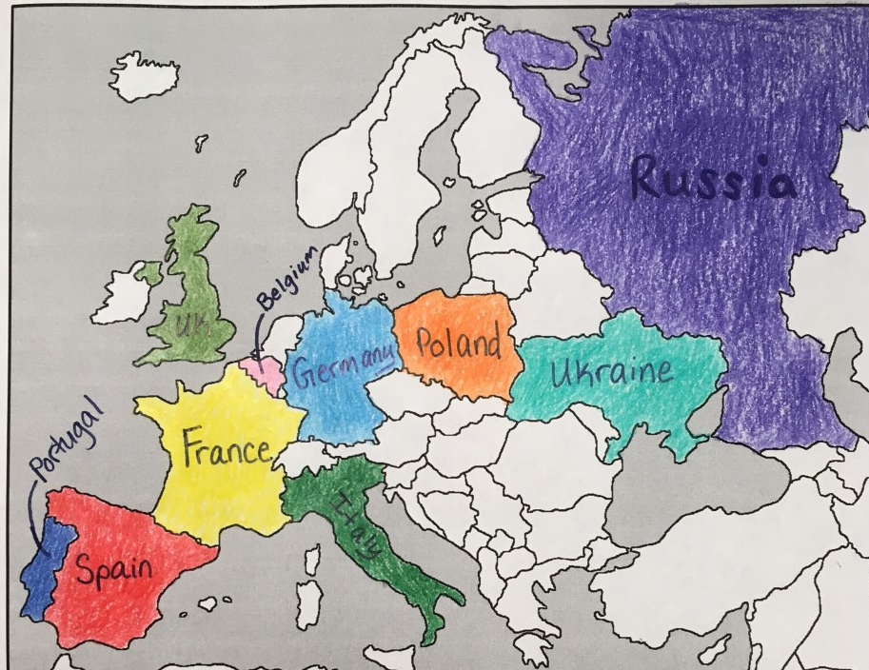
Mneumonics
Pretty Spectacular Flying Bunnies Go Poop Under Rugs
Patiently Shopping For Bunnies Gives People Ugly Rashes
Poured Sugar For Babies- Got Pull Ups Right?
Purple squirrels fly beyond good pork under rocks
People say French baguettes get pointy under raisins
Playful Screaming Fluffy Bunnies Giggle Pointlessly Under Rugs
Portugal
Spain
France
Belgium
Germany
Poland
Ukraine
Russia
YOU STILL NEED TO KNOW ITALY AND UNITED KINGDOM!

Slide 2
Know the capitals too! Agh!
Belgium- Brussels
Germany- Berlin
Poland- Warsaw (Hitler invading Poland began WWII)
Ukraine- Kiev
United Kingdom- London
Portugal- Lisbon

Slide 3
What about the other capitals?
France- Paris
Italy- Rome
Russia- Moscow
Spain- Madrid

